Slide 1
Expectations for Cloud Ready Applications
Ranjan Prasad and Brian Rieger
June 2019

Slide 2

Agenda
What is Cloud Ready?
Differences to Traditional Delivery
Measuring maturity
Enhancing Cloud-ready applications with 12-Factor
Notes:
SAY:

Slide 3
Objectives
Understanding of
Cloud Ready
Cloud Native
12 Factor
Notes:
SAY:
After completing this session, you should be able to:

Slide 4
Cloud Ready Applications

Slide 5
Health Care Cloud | What is Cloud Readiness?
Cloud Readiness Introduction
The Cloud Roadmap
“Cloud Readiness represents the Maturity of an organization, to identify Appropriate Cloud-services, which Generate value. Cloud-services have to be integrated efficiently and target oriented
Within enterprises in order to be able to Manage their use and allows the agile change of Cloud-Service provider”
Cloud Need Identification
Cloud Readiness Assessment
Risk & Benefit
Analysis
Business Case
Cloud Strategy
Transformation Roadmap
“Today’s best Practices are tomorrow’s anti-patterns.”

Slide 6
Need for Cloud Ready
Customer expects it
Gives you more business options
Your competitors are doing it
Meet demand to operate at scale
It makes everyone happier

Slide 7
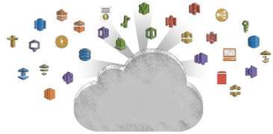
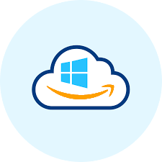
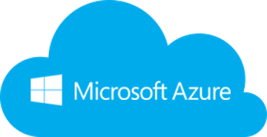
There are many reasons to move to the Cloud
Why? What? How ?
Agility
Platform Breadth
Cost Savings and Flexibility
Continual Iteration and Innovation

Slide 8
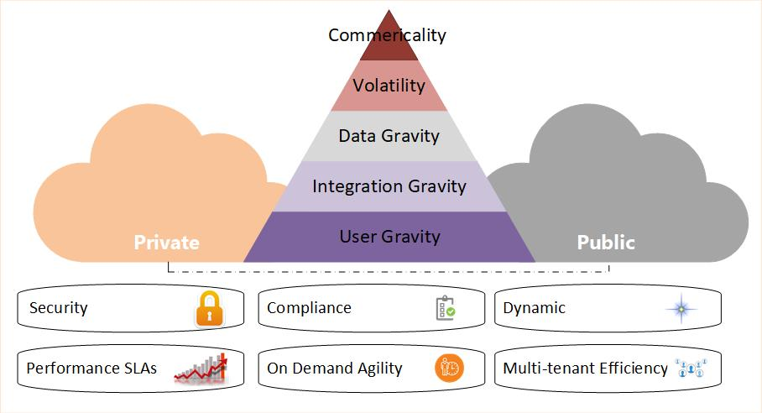
There are many reasons to move to the Cloud
Why? What? How ?
What workloads can be moved to the cloud:
Strategy & Business Goals: Applications, Processes, Data & Storage “SaaS, IaaS, PaaS”
What are the business priorities?
What technology is the business using?
What are the usage requirements?
What is the budget?

Slide 9




There are many reasons to move to the Cloud
Why? What? How?
Cloud Assessment
Phase
Proof of Concept
Phase
Data Migration
Phase
Application Migration
Phase
Leverage the Cloud
Phase
Optimization
Phase
Assess Cost
Assess Architecture
Assess Security
Learn Azure, K8s…
Build a Pilot
Build support within your Org
Leverage different Storage Options
Migrate
Forklift Migration
Strategy
Hybrid Migration Strategy
Auto-scaling
Automation
Elasticity
High-Availability
Utilization
Monitoring
Efficiency
Performance
Re-engineering
What you’ll need in this journey
Cloud Eng. Team
Training
Enterprise Support model
Discovery & Assessment Process defining the roadmap, quick wins and adoption plan
TCO analysis and business case
Business benefits and value analysis
Cost of migration and execution plan
Technology assessment
Security assessment
Portfolio evaluation
Technology partners
You’ll need a guide
You’ll need a map
You’ll need a reason
You’ll need tools

Slide 10
Cloud-Native
What is cloud-native all about?
This is an approach to building and operating software that takes advantage of the cloud-computing delivery model. Often seen as a combination of microservices, continuous delivery, containers, and DevOps.
Apps Characteristics
Visible
Ability to measure a service in your cloud
Disposable
Services do not maintain state and can be removed at will
Repeatable
Mature CI/CD pipeline produces predictable builds and deployments
Follow 12-factor
Applications adhere to the 12-factor app
Secure
Applications know how to utilize AuthN and AuthZ
Distributed
New Services can be found & accessed through a decoupled communication interface
Performant
Applications are built to emphasize boot-up speed and focus on resource needs

Slide 11
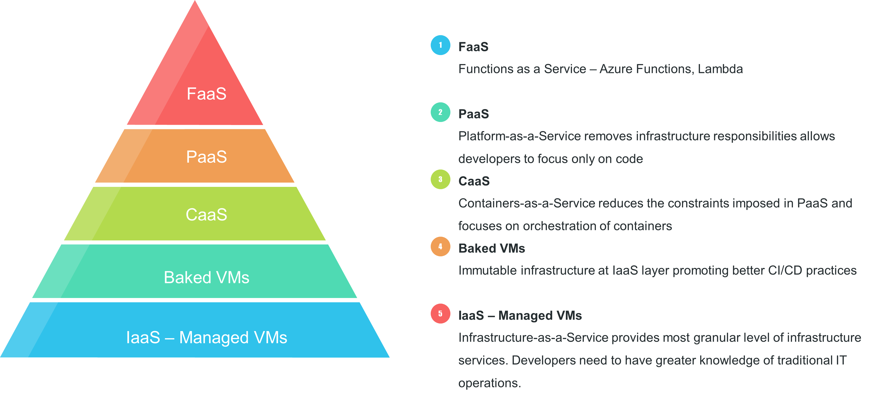
Cloud Compute Layers

Slide 12
Traditional VS Cloud-Native
 | Traditional | Cloud-Native
Operating System | OS Dependent | OS Abstraction
System Status | Un Predictable | Predictable
Capacity Planning | Oversized Capacity | Right Size / Elastic Scale
Delivery Method | Waterfall | Continuous
Scaling | Manual | Automated (Intelligent)
Recovery | Slow Recovery | Rapid / Auto-healing

Slide 13
Eight-Core Principles
Process must be repeatable & reliable
Automate everything!!
If something is painful, do it more often
Keep everything in source control
Done = Released!
Build quality in (make metrics visible)
Everyone is responsible for the release
Improve continuously

Slide 14
Four Core practices
Anything breaks, all hands-on deck
Building software is the responsibility of the entire team. Any problems and everyone should help to solve the problem (and create tests to cover the cause)
Build binaries once
Use the same mechanism to deploy everywhere
Smoke Test / Deploy Frequently
Automate infrastructure for parity between environments, automate deployments to match each environments in progression
Practice deployments often to avoid last minute or risky deployments to production
Final binaries and/or packages should be versioned and immutable

Slide 15
Health Care Cloud | Cloud Readiness Vs Cloud Native
There is a maturity model to cloud native.
Cloud Ready
Cloud Friendly
Cloud Resilient
Cloud Native
No File System Dependency
Self contained application
Platform managed ports/address
Consume off-platform services
Twelve factor app
Horizontal scalable
Leverage Platform for HA
Designed for failure
Apps unaffected by dependencies
Proactive failure testing
Metrics and monitoring baked in
Cloud agnostic runtime
Microservices architecture
API-first design

Slide 16
Assess Your Cloud Readiness
General guidance to help make the pre-migration planning
A Business Case for Cloud Migration
Estimate Timeline and Budgets
Establish a Cloud Operating Model
Assess relative complexity and risk of migrating a service to a cloud solution
Determine which of the 6 "Re-s" are most appropriate for this services:
Remove/Retire
Retain: Keep in a DC, somehow
Repurchase
Rehost
Replatform
Refactor/Rewrite
Notes:
https://github.com/18F/cloud-assessment/blob/master/assessment.md

Slide 17
Cloud-Native
Maturity Matrix Categories
Design
Build
How solutions are built and adhere to cloud-native principles
Test
Deploy / Lifecycle
Defined capabilities controlling the deployment & lifecycle of services through automation
Monitor
Processes & tools associated with how a service designed
Methodologies & Implementation tactics for ensuring quality & Completeness
Mechanism & Tooling used to enhance observability and adhere to SRE principles

Slide 18
Cloud Ready using 12-Factor principles
Brian Rieger

Slide 19
The 12 Factors
Origins
Designed by Heroku 2012
Focus on stateless compute containers
Best Practices & guidelines, not rules
Embodies Cloud Native best practices
Codebase
Dependencies
Config
Backing Services
Build, Release, Run
Processes
Port Binding
Concurrency
Disposability
Dev/Prod Parity
Logs
Admin Processes

Slide 20
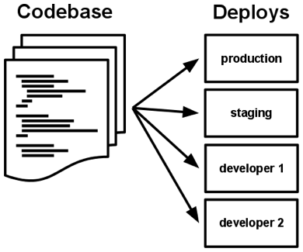



#1 & 2 Codebase and Dependencies
Codebase
One Codebase should be used to track all changes to the application such as Git or Mercurial
Each Codebase can have numerous different deploys for all of the environments needed
Dependencies
Should be explicitly declared and isolated
Handled by common tools such as Gradle or Maven
Eliminates Dependency on system-level tools or libraries.
Notes:
5 to 10 years ago people did version control just by copying folders over and taking backups. It was a mess and very hard to keep track of. In today’s world we have tools like git and mercurial they allow you to check in updates and create branches so Ranjan can have his own branch, I can have my own Branch, and Anil can have his and we can merge my branch and Ranjan’s to the master and allow Anil to keep working on what he is doing.
When it comes to dependencies we longer need to download any additional libraries we need directly from the source and and add them. Now we simply use tools like maven or gradle to handle our dependencies for us. We simply specifcy a version of jars and a list of all of the needed dependencies and maven or gradle will manage this for us

Slide 21
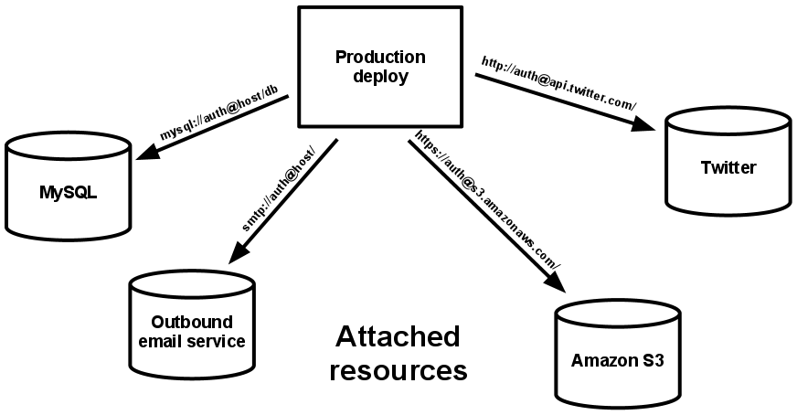
#3 & 4 Config and Backing Services
Config
Should be stored within environment variables
Backing Services
Think of backend databases, caches, etc. as attached resources that are configurable.
Code should be agnostic of the backend
Easily switch between different types of database with no code change
Notes:
Configs should not be stored with a differenct copy for your local, your dev, your prod, etc. Instead one master config should be used where the parameters are set to the values of env variables. So you would have var mydb=ENV[‘MYDB’] that way you avoid the chances of deploying your dev config to production and then panicing as you attempt to undo the change and cleanup any data that may have gone to the wrong location.
When it comes to a 12 factor application they are usual stateless meaning they are independent of your backend services. The backend can be easily swapped in and out by switching the value of the env variable you have set for your backend. For example you would switch out your mysql backend url for a postgresql one and connect to the new database instead of the old one.

Slide 22
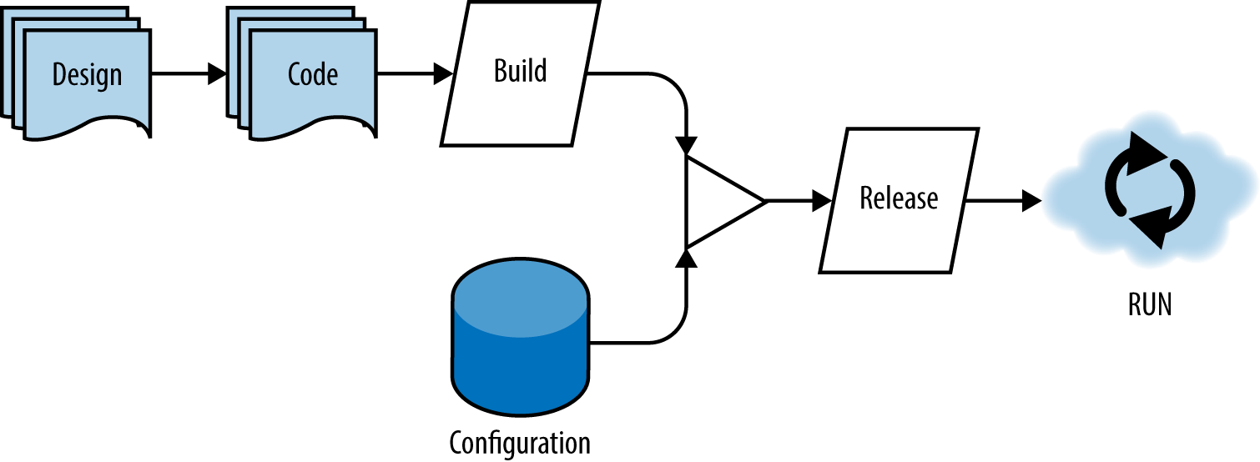
#5 & 6 Build, Release, Run and Processes
Build, Release, Run
Build – Code that has been compiled and has all of the needed dependencies downloaded by the dependency manager
Release – A release combines the built code with the current deployments configuration.
Run – An app running in an execution environment that is comprised of numerous processes
Processes
Execute the app as one or more stateless processes
Notes:
Code that has been compiled and has all of the dependencies wrapped into it is considered a build. However if you were to execute that without the config it would fail. Code paired with a config is considered a release. For each change in code or a change in the config a new release should be created. Usually you would want to create a tar or a zip to tie these together. Even if it is a simple change like a password change you should create a brand new release. That way if the password was not correctly changed you could simply grab the old release tar ball and run it. A run is a release that has been executed into an environment.
Processes. Each app should be broke up into a series of statelss processes. Instead of having just one process running you would create a separate process for each component you could have a process running for your web-app, one for your customer api, another for your sales api, and another for your inventory api. This makes debug much simpler as you know the exact process that had the issue and know exactly where to go to fix it.

Slide 23
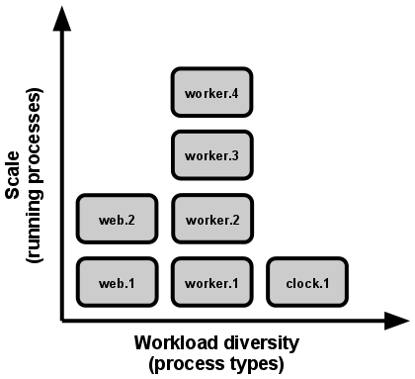
#7 & 8 Port Binding and Concurrency
Port Binding
Each Application should be bound to a specific port so that it can be easily accessed by other applications
Should not rely on a runtime injection of a webserver
If one app is a backing service for another app the details on this port can be stored within the config.
Concurrency
Duplicate processes can be spun up and load can be split across them.
Container Orchestration Engines Handle a lot of this for you (Kubernetes, Openshift, Azure)
Notes:
Applications should be bound to one specific port. When it comes to webapps it is usually port 80 for http and port 443 for https. Apps also should not rely on webserver being injected at runtime. The webserver should be baked into the application. If one app is the backing service for another one these details should be stored in your env variables which are picked up by your configs.
As I mentioned previously apps should consist of numerous processes. These process can then be spun up concurrently as load increases to handle more traffic. You could spin up numerous instances of one of your api’s if the traffic to it increases and then have the load balanced across all of them. This is even easier to do as we move into the world of cloud computing where Kubernetes and other container orchestration engines have objects like horizontal pod autoscalers which will monitor the memory or cpu usage of your process and scale it up and down as needed.

Slide 24

#9 &1 0 Disposability and Dev/Prod Parity
Disposability
In a containerized world containers can move to a different physical node at any point
SIGTERM can be utilized when a graceful shutdown happens
Use queues to deal with application crashes
Dev/Prod Parity
Time Gap – Within hours or minutes after a developer writes code it should be deployed to production
Personnel Gap – A developer who writes code should be involved during the deployment and also monitor the applications behavior
Tools Gap – Tools used in a development environment should be identical to those used in production. In a containerized world this is very possible.
Notes:
Applications and their processes should be able to be torn down at a moments notice. The node could go down that the process is running on or it could be preempted and moved elsewhere. From an end user perspective this should be seamless. You can utilize sigterm to allow for graceful shutdowns but you need to design your app with crashes in mind. Meaning that no transactions are lost and if a processes crashes a new one seamlessy takes over. You could utilize queues to handle this.
There should be a small gap between the time a developer commits new code and when it is deployed to production. Instead of a monthly deployment of a release there should be 100s of them. This will result in less bugs as new bug fixes are constantly pushed. The same developer who wrote the code should be responsible for monitoring the application and ensuring that it is stable. Additionally if you are using one database in production your local database as well as your development namespace should be the same. In a containerized world this is easy to do as you can spin up a postgresql in a container and easily make sure your env on your local is identical to that of production.

Slide 25


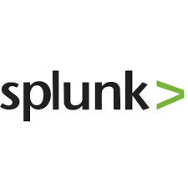
#11 & 12 Logs and Admin Processes
Logs
Should be an event stream
Send them to stdout and stderr for aggregation
Have a collector running such as Fluentd or Filebeat that ships the logging over to an analytics tool such as Splunk or Elasticsearch
Admin Processes
Run admin/management tasks as one-off processes
Keep admin tasks in source control and packaged alongside the application
Notes:
Logs should be sent to an event stream that can be subscribed to. It will allow for quick filters on all of the different processes and make debugging simple. Then you can have a log aggregator set up to scrape your logs and ship them over to elasticsearch or splunk.
All admin process should be one of processes and managed with your codel.

Slide 26



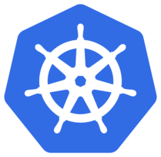
Deploying a 12 factor app into OSFI Kubernetes
Store Version
Web App
ISCSI Block Storage - Flash
NFS NAS/Flash
Application Code
Kubernetes Yamls
Dockerfiles
Jenkinsfiles
Create and test build pipeline
Database
Run Deployment
API
Notes:
In Optum your 12 factor app can be set up by using git for your source control. You check in any code in any language into git and create different branches for different versions of the code. You can then package up a release by creating a tag in git.
A webhook can be set up between github and Jenkins that will automatically trigger a new build when a push to the github branch happens. This build would take the source code compile it with all of the dependencies bundled, build the binary into a docker image, store the brand new docker image in a docker registry, and then your app would be deployed to kubernetes via Jenkins which would pull down the new image and run it in the kubernetes cluster with all of your env variables provided via kubernetes yamls.
This will all be highlighted in the cloud migration workshop tomorrow

Slide 27
Questions?

Slide 28
Ranjan Prasad ranjan_prasad@optum.com
Brian Rieger brian.rieger@optum.com

Slide 30
What is Serverless?
Traits of Serverless (function as a service)
No Server Management
Performance capabilities
AutoScale
High Availability
Precise Costs
The 3 factor Application
Factor #1
Realtime GraphQL
Factor #2
Reliable eventing
Factor #3
Async Serverless
Notes:
Ref: https://3factor.app/

Slide 31
Data Centric Applications in Cloud
Speaker Name

Slide 32
Data Centric Applications in Cloud
Initially Figured Data Services Would be Further Down the Road
Storage and networking bandwidth requirements made data services prohibitively slow in cloud environments
Some advantages to applications don’t apply to data products (e.g. horizontal scalability, etc.)
Software not designed to run under container orchestration systems
However
Storage and networking infrastructure have made amazing strides recently
Open source communities are creating Kubernetes compatible versions of software
Cloud Advantages for Data Stores and Analytics Workloads
Leveraging elastic compute resources for exploratory and periodic analytics work loads
Dynamically provision test environments
Usage based chargeback models
Flexibility, Scalability, et.
Given advancements in infrastructure and stateful software we’re pushing ahead with offering data services within OSFI

Slide 33



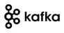












Data Centric Applications - Strategy
Data Scientists
Developers
Data Engineers
Data Analysts
OSFI
BDPaaS
Member
Provider
Big Data Tools
ML / DL Tools
Data Services
Bring-Your-Own
Claims
Clinical
Data Catalog
Traditional Big Data Tools
Elastic Compute – Self-service, multi-tenant
YARN – Multi-tenant
Flexible Storage – HDFS with S3, Volume Plugins
Big Data Storage - MapRFS
Compute
RAM
CPUs
GPUs
Storage
NAS/FLASH
SSD/HDD
Availability Zones – Optum Data Centers
On-Premises DC

Slide 34


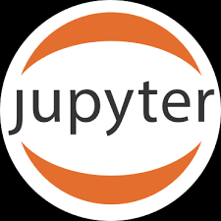
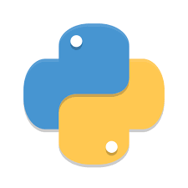
How to Run Data Centric Tools in OSFI
Reusable and customizable Big Data tools will be published and managed in Optum Helm Chart repo
Master
Worker
HDFS with S3
MapRFS / BDPaaS
ISCSI Block Storage - Flash
NFS NAS/Flash
Optum Object-Store
Worker
Clone Optum Chart repo
Customize Charts
Create and test build pipeline
Deploy applications
Manage versions
LLAP
Applications
Big Data Store

Slide 35



Cloud | Customer Maturity Solution Evolution
HealthCare Cloud
Core Product Development Teams Spend time Building Components & Services
Automation & Tools
HealthCare Cloud & Platform
Build Components (A, B, C, D,)
Build Component Sets (A+ B +C= Solution X)
Goal: Provide Teams with “Lego” kits / Paved Paths via pipelines / pattern
Build Core Products
+
=
Data S.1
Infra S.1
+=
=
Upon intake Teams are directed to the correct component(s) based on assessment & workload placement.
Immature Teams trying to
compile components to Application Solutions
Infra S.2
Data S.2
Today
2019 2020

Slide 36


Cloud | Customer Maturity Solution
HealthCare Cloud
Automation & Tools
Build Healthcare Products.
Build Innovative
Healthcare Products.
+=
+
+
=
Innovation
+
Teams can then Spend time Building Healthcare Products
2021 2022 Future

Slide 37
Cloud | Customer Maturity Solution
Infrastructure Capabilities
Compute
Storage
Network
Metrics/logging
CI/CD
Workload Placement
Security/ Monitoring
HealthCare Cloud
Automation & Tools
Build Components (A, B, C, D,)
Build Component Sets (A+ B +C=X)
Build Core Products
Build Healthcare Products.
Build Innovative
Healthcare Products.
+=
+
+
+
=
Innovation
+=
=
+
Core Teams Spend time Building Components & Services
Teams can then Spend time Building Healthcare Products
2019 2020 2021 Future

Slide 38
Health Care Cloud | 2018 Workload Placement Decision Tree
Reasons to go public
Commercial intent
Volatile Workload
Internet-facing B2C or geographically sensitive consumption
Workload Quarantine
Un-adopted/emerging Tech
Critical feature availability
Otherwise, default to on-prem private cloud.
On-prem private cloud is the default – it leverages our modernization to cloud while utilizing the assets in the data centers we already own adjacent to other related applications or data.
OSFI
or
OSE
PRIVATE
Public
or
Private?
HYBRID
YES
Developer
Needs
Hosting
Cloud
Ready?
Azure
or AWS
Public cloud is a high-accountability zone that is best suited for certain kinds of workloads and/or those with commercial intent.
PUBLIC
Cloud-ready Characteristics
Application is architected to be stateless, have external config, ships logs, is API- and microservice-based, is 12-factor, and has portable data.
Team is competent with modern development approaches and technology, and is prepared to operate cloud applications.
Operations is ready with correct instrumentation, telemetry, and dashboarding.
If not, consider pathway to cloud guidance!
NO, WITH
EXCEPTION
Go to Public Cloud Onboarding and Governance
HYBRID
NO
VMaaS
(UCI)
On-prem managed VMs will always be relevant for ERP and old-style stateful applications.
Possible Exceptions Include
Acquired entity legacy placement
Obligatory legacy migrations
Possible analytical cases
All exceptions will be tracked.

Slide 39
Healthcare Cloud Strategy

Slide 40
Healthcare Cloud Vision
Enabling teams to deliver value safely, quickly and sustainably in the Healthcare Cloud
to help people live healthier lives and to help make the health system work better for everyone.
Private and Public Cloud teams being unified creates one user experience for access, assistance, solutions, information and documentation.
Provide for an orderly adoption of Healthcare cloud services with visibility into who is utilizing, what is being used, how much we are spending, and what risks we are exposing.
Provide key stakeholders approval at point of decision for workload placement, product strategy and team maturity.
Provide for the on-going monitoring and review of products and services used on public cloud for risk evaluation, financial oversight, and future contract negotiations.
Healthcare Cloud governance and enablement strategy is predicated on automation, enabling code and platforms that accelerate adoption.

Slide 41







Healthcare Cloud- Foundational!
Ecosystem
Healthcare Data Platform At-a-Glance
Healthcare Experiences
Consumer Applications
Clinical and Rx Applications
Provider
Applications
(EMR, etc.)
…
Enterprise and
Commercial
Omnichannel Experience Management
HEALTHCARE PLATFORM
Foundation
Healthcare Capabilities
Referral
Management
Scheduling
As a Service
Healthcare
Experience
Storefront
AI-based
Decision
Support
Healthcare Interoperability
OptumIQ
Common
Capabilities
Centralized Distribution Services
Common
Frameworks &
Components
Identity and
Authentication
Search
Interoperability with partners (via FHIR, X12, ODX, etc.)
CORE
Healthcare
Data Platform
Source, normalize, master, and present consistent data at massive scale
IHR
Benefits
Claims
Consumer & Eligibility
Providers
Clinical & Wellness
Constituent Communications
Cross-domain & Miscellaneous
Financial
Healthcare
Cloud
Infrastructure Capabilities
Compute
Storage
Network
Metrics/logging
CI/CD
Workload Placement

Slide 42
Healthcare Cloud | The Path Forward
Automate
Save 70% or more through automating operation and deployment
Reduce operating and maintenance labor
Optimize
Save 40% or more through automated scaling
Eliminate unused capacity
Modernize
Save 90% or more with modern platforms and architecture
Replace per-server costs with per-member costs
Iterative advancement starts with hardened automation
Automate
Optimize
Modernize

Slide 43
2019 Workload Placement Decision Tree
Reasons to go private
Critical feature availability
Intractable data/user/ integration gravity
Data sensitivity issues
Otherwise, default to public cloud.
OSFI
or
OSE
On-prem private cloud is suitable for cases where there is intractable issues of data/user/integration gravity.
PRIVATE
Public
or
Private
?
HYBRID
YES
Application
Needs
Hosting
Cloud
Ready
?
Azure
or AWS
Public cloud is a high-accountability zone that is well suited for most kinds of workloads. Be cautious of data/user/integration gravity
PUBLIC
Cloud-ready Characteristics
Application is architected to be stateless, have external config, ships logs, is API- and microservice-based, is 12-factor, and has portable data.
Team is competent with modern development approaches and technology, and is prepared to operate cloud applications.
Operations is ready with correct instrumentation, telemetry, and dashboarding.
If not, consider pathway to cloud guidance!
NO, WITH
EXCEPTION
Go to Public Cloud Onboarding and Governance
HYBRID
NO
VMaaS
(UCI)
On-prem managed VMs will always be relevant for ERP and old-style stateful applications.
Possible Exceptions Include
Acquired entity legacy placement
Obligatory legacy migrations
Possible analytical cases
All exceptions will be tracked.

